Slide 1
Web Science:
Disinformation
(HW6 - Analyzing Disinformation)
CS 432/532
Old Dominion University
Permission has been granted to use these slides from Michele C. Weigle
This work is licensed under a Creative Commons Attribution-NonCommercial-ShareAlike 3.0 Unported License

Slide 2
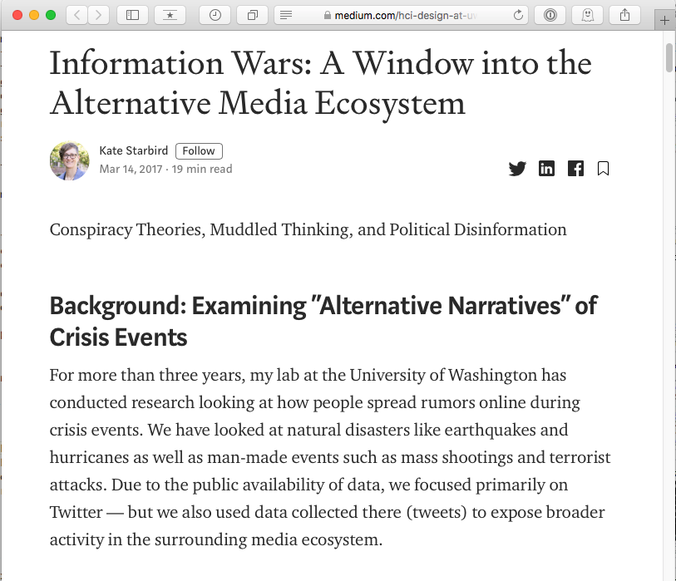
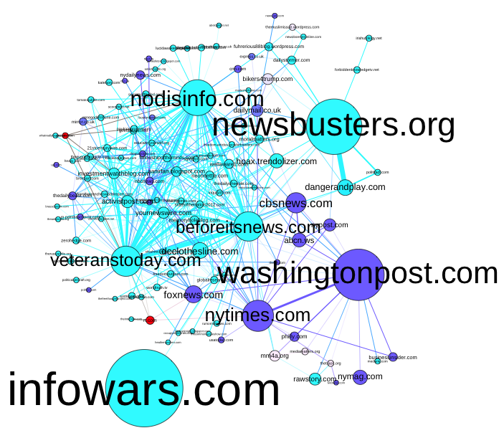
Starbird, ICWSM 2017
Starbird, “Information Wars: A Window into the Alternative Media Ecosystem”, March 2017
Starbird, “Examining the Alternative Media Ecosystem through the Production of Alternative Narratives of Mass Shooting Events on Twitter”, ICWSM 2017

Slide 3
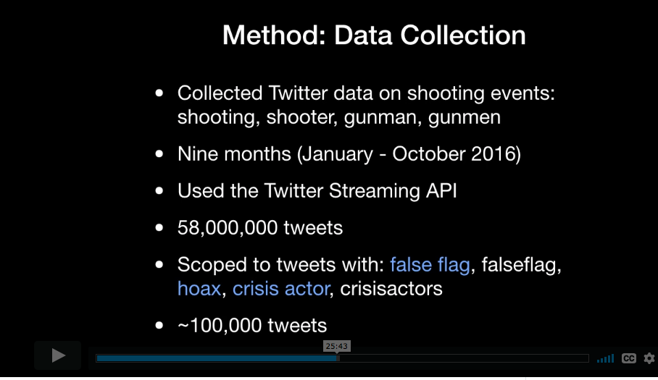
ICWSM 2017 Data
Starbird, "Muddied Waters: Online Disinformation During Crisis Events", video, 2018
Starbird, “Examining the Alternative Media Ecosystem through the Production of Alternative Narratives of Mass Shooting Events on Twitter”, ICWSM 2017

Slide 4
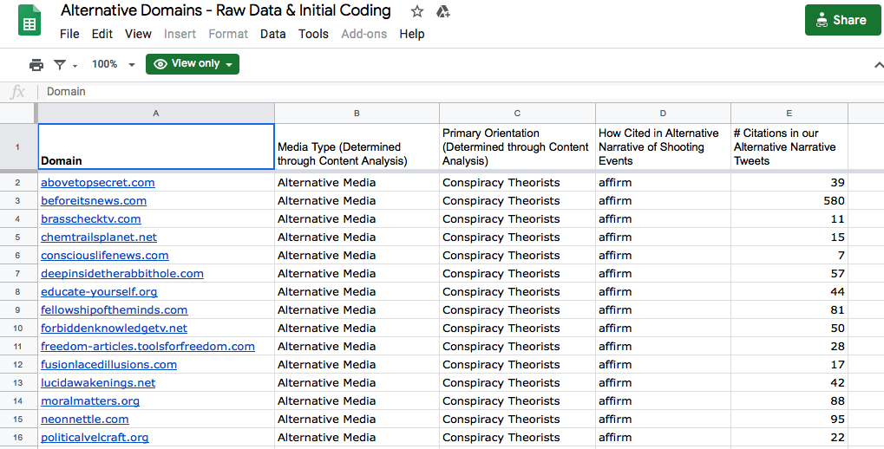
ICWSM 2017 Data
Starbird, “Examining the Alternative Media Ecosystem through the Production of Alternative Narratives of Mass Shooting Events on Twitter”, ICWSM 2017 - data file on Google Sheets

Slide 5
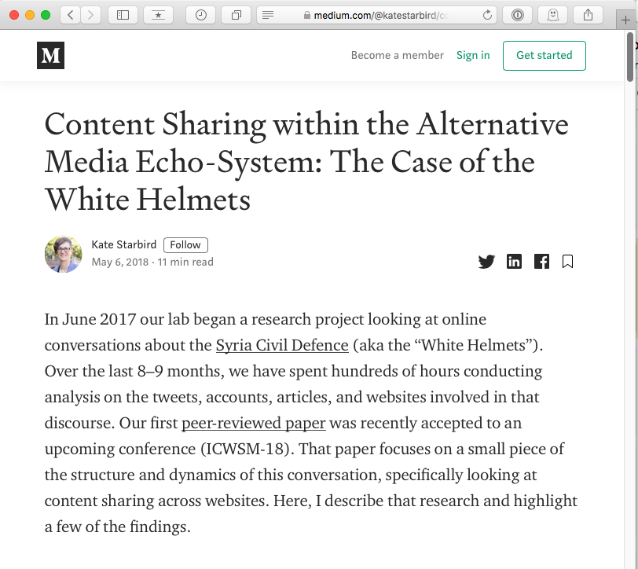
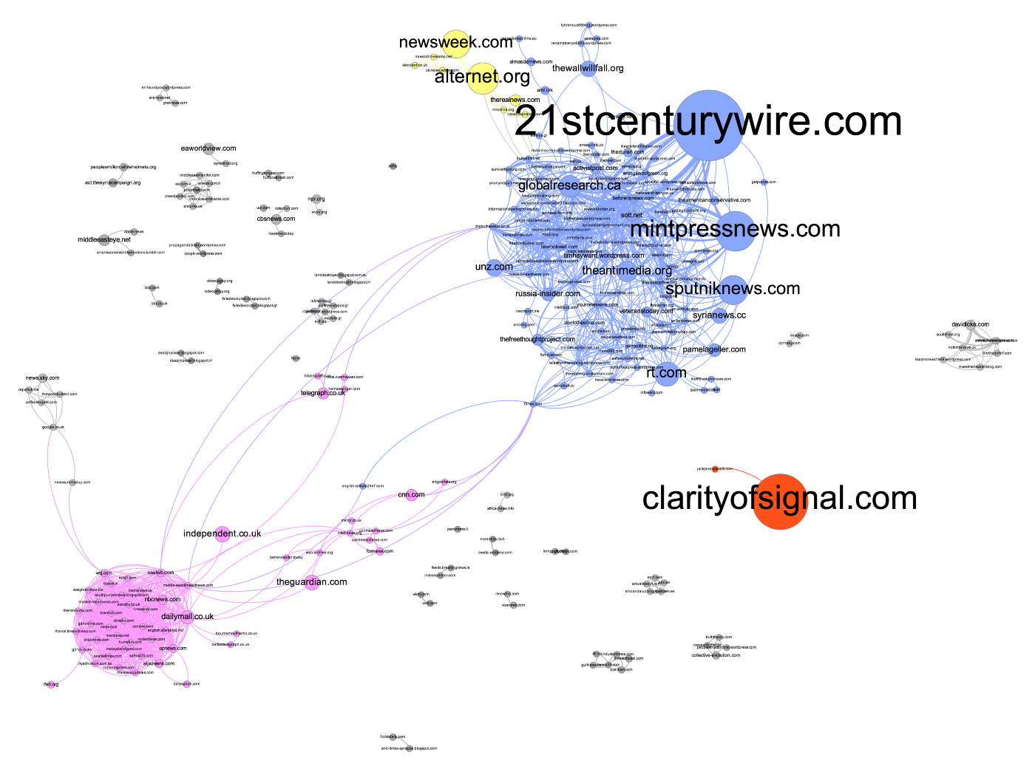
Starbird, ICWSM 2018
Starbird, “Content Sharing within the Alternative Media Echo-System: The Case of the White Helmets”, May 2018
Starbird et al. “Ecosystem or Echo-System? Exploring Content Sharing across Alternative Media Domains”, ICWSM 2018

Slide 6
ICWSM 2018 Data
Tweets collected between May-Sep 2017
135,827 tweets contained “white helmet” or “whitehelmet”
52,903 tweets contained a URL
3410 distinct URLs
1680 distinct news articles
removed URLs that linked to similar articles within the same domain
Starbird, Arif, Wilson, Van Koevering, Yefimova, and Scarnecchia, “Ecosystem or Echo-System? Exploring Content Sharing across Alternative Media Domains”, ICWSM 2018

Slide 7
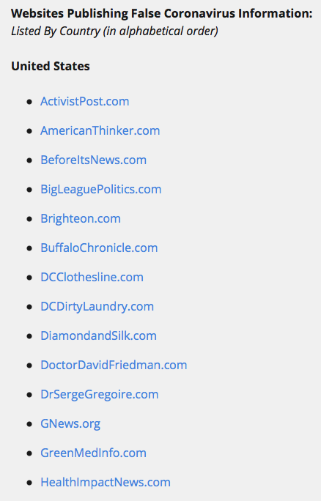
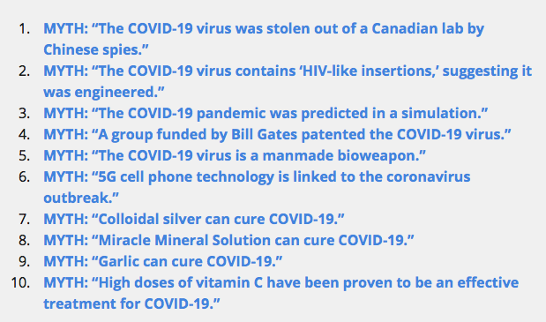
Tracking Coronavirus Misinformation
Special Report: COVID-19 Myths – NewsGuard
Coronavirus Misinformation Tracking Center – NewsGuard

Slide 8
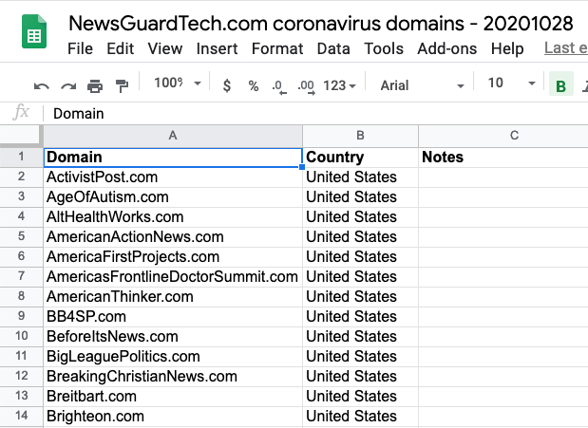
NewsGuardTech Data
data collected 10/28/2020
347 domains
Coronavirus Misinformation Tracking Center – NewsGuard
data file on Google Sheets

